Slide 1
41889 IOS A3 Tut 05
Group 6:
Yuhao Jiang 13345804
Jiawei Liang 13814241
Junjie Yang 14073225
Bohui Liu 13334228
Tutor: Xujie Song
Email: Xujie.Song@uts.edu.au

Slide 2
Problem should be solved
Design an online booking system for restaurants or cinemas. The app should allow the customers to select seats and cancel the booking

Slide 3
Project Development Process
complete all transfer and integration
5.6
5.18
5.21
Film Page : show all films -> click film jump to Film Detail Page -------- Yuhao
Film Detail Page : show details of selected film -> sekect time and click booking button jump to Seats Page -------- Jiawei Jerry
Seats Page: show all seats and their status -> select seat and click book jump to Ticket Page, otherwise throw error -------- Junjie
Ticket Page: show the detail of booking information include film and seat info -------- Bohui Liu
Presentation

Slide 4

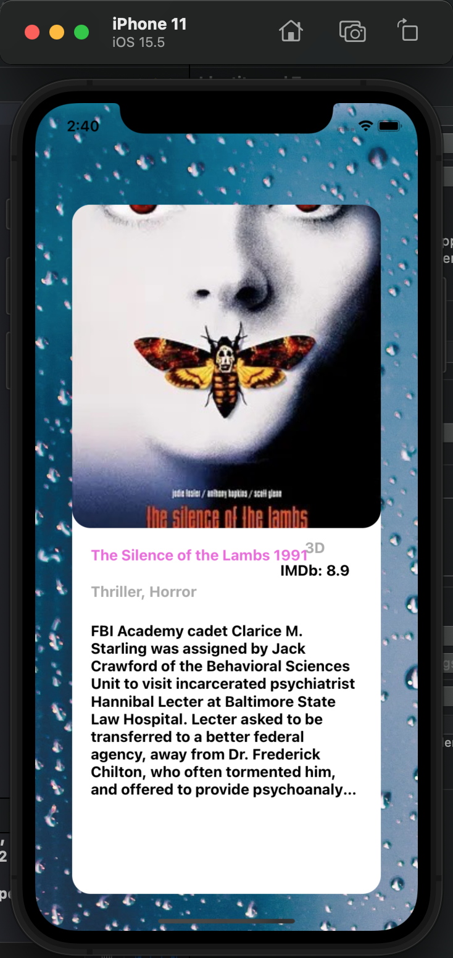
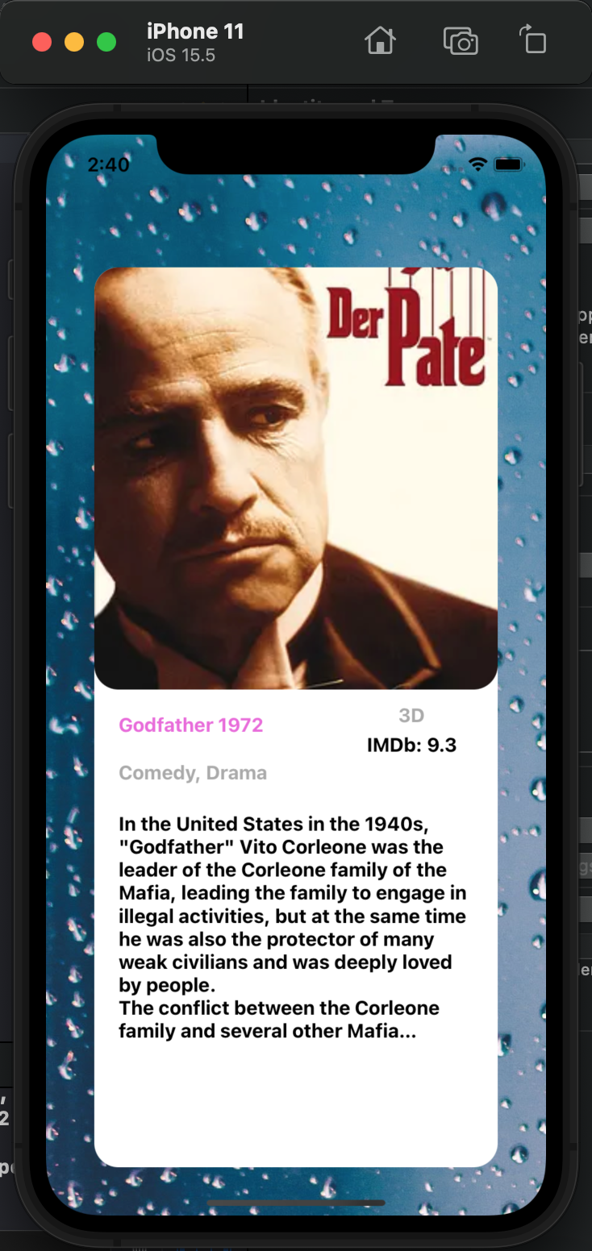
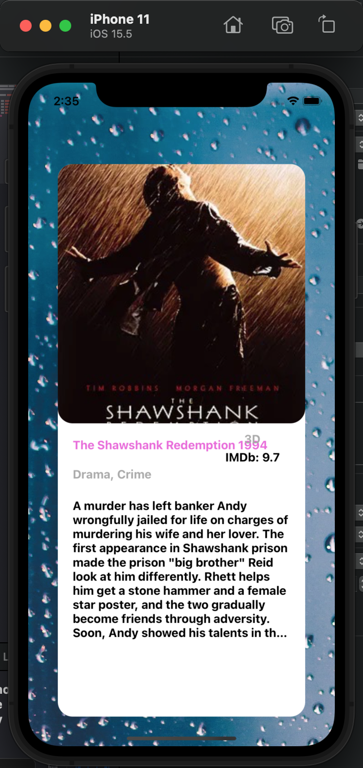
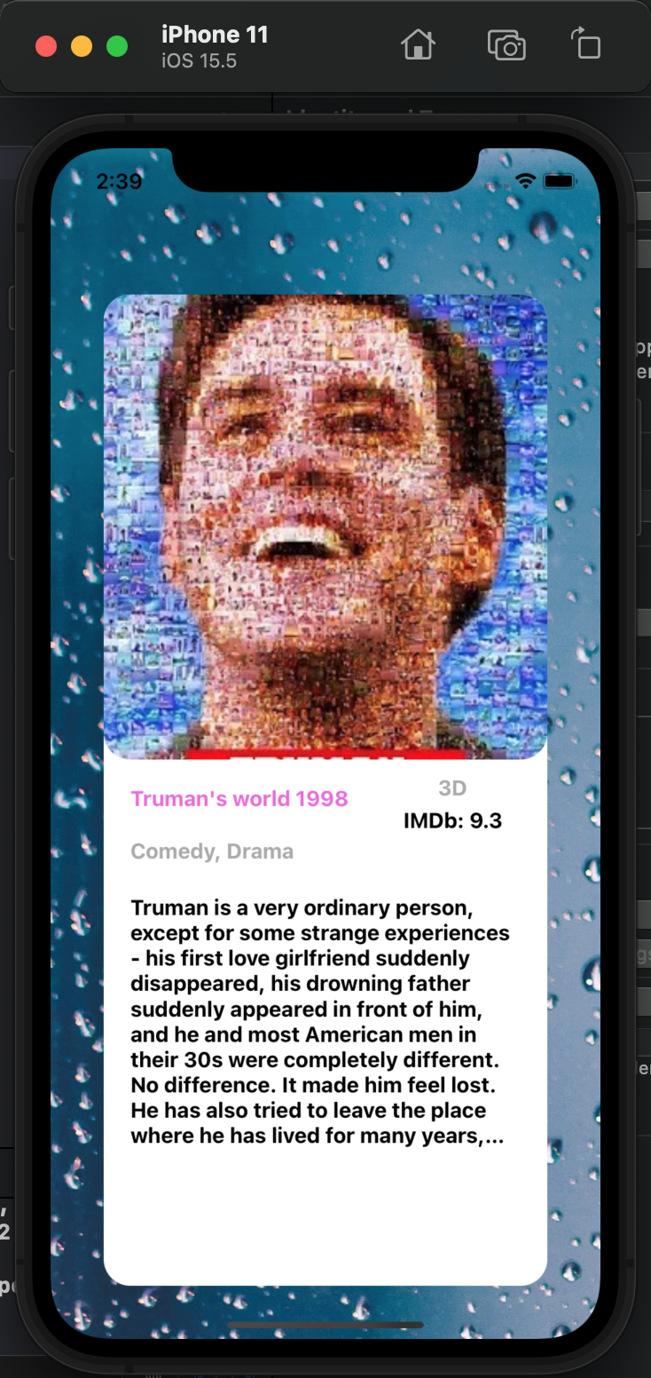
Section 1: Film Page

Slide 5
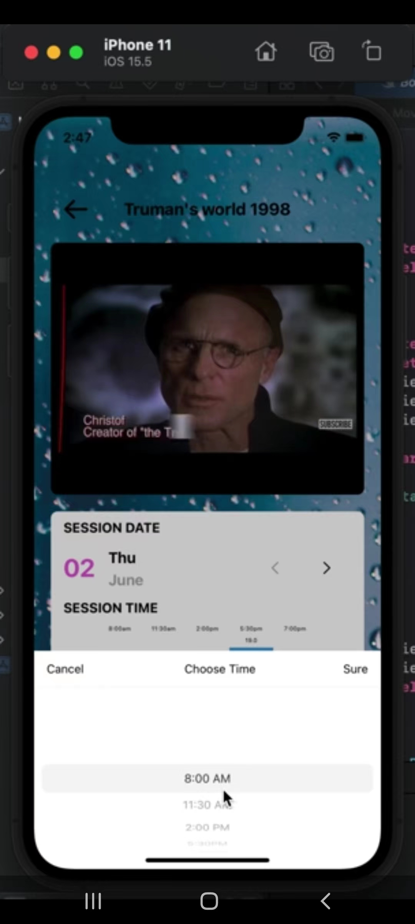
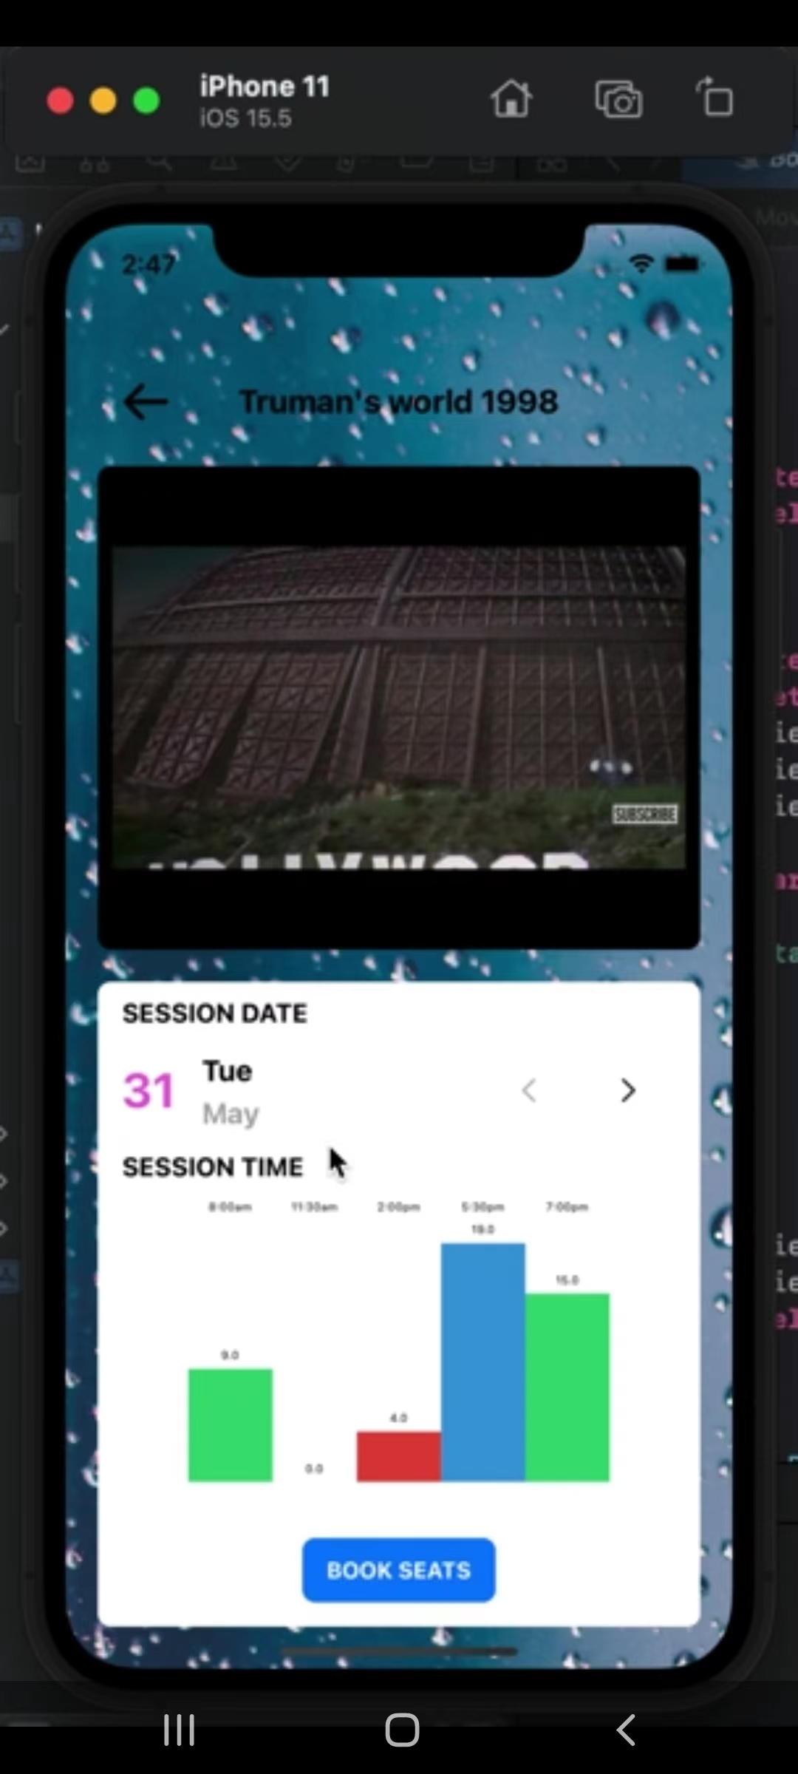
Section 2: Film Detail Page

Slide 6
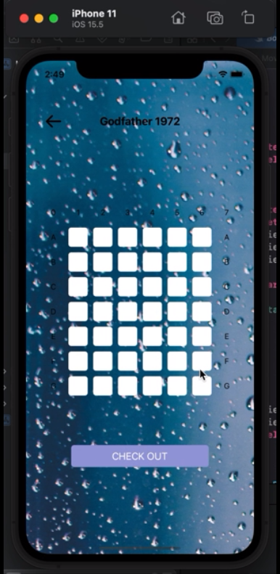

Section 3: Seat Booking

Slide 7
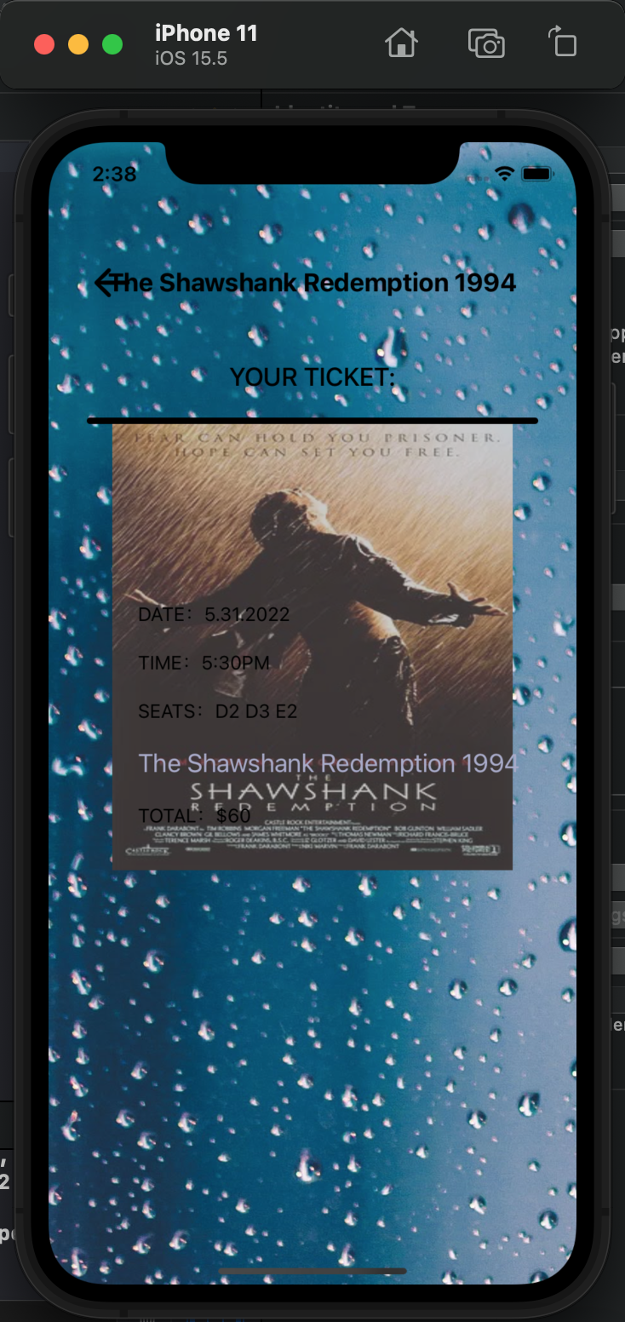
Section 4: Generate Tickets

Slide 8
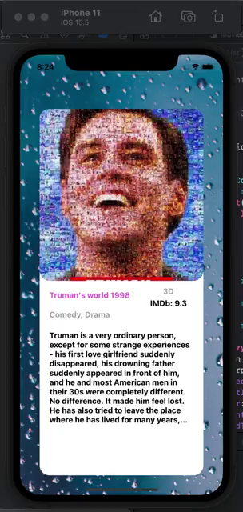
Application Showcase

